Slide 1
Notes:
Good to see you all here today - my name is christopher martin - i am founding director of a transport and urban design practice called - urban movement - and we work to improve quality of life in urban areas - through the strategy and design of transport, streets, and public realm projects.

Slide 2
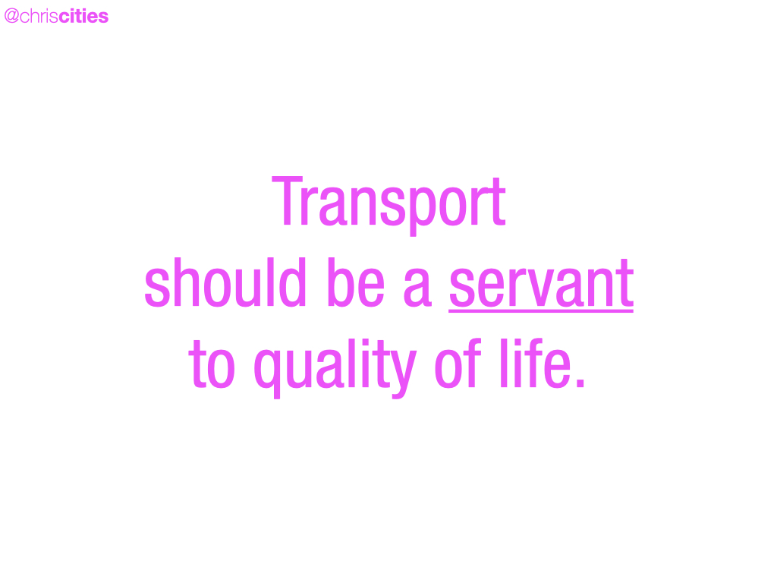
Notes:
THIS IS WHAT MAKES A PLACE AMBITIOUS - REALISING THIS - THAT Transport is a tool at our disposal - that needs to be used - to serve our collective quality of life.

Slide 3
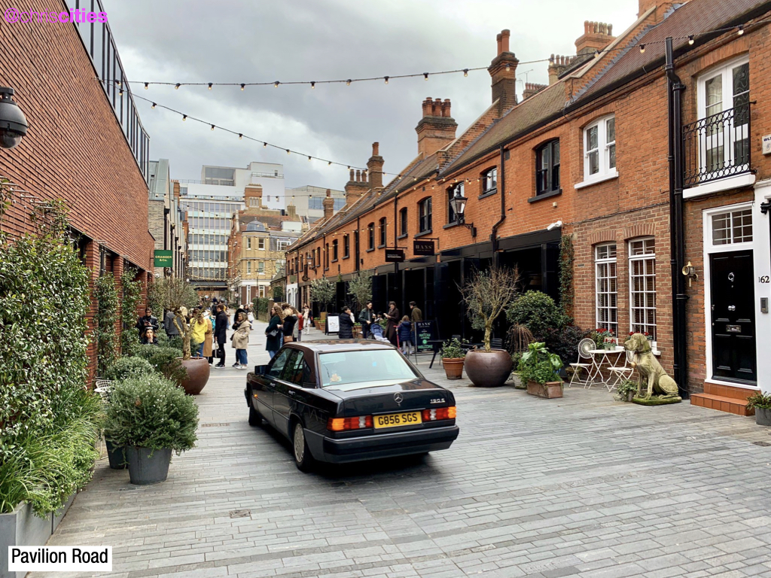
Notes:
How we shape towns - cities - and urban areas — simply has to be governed by what yields the maximum return on investment - for people and society - from the space we have available.
Investment in our public realm - and in our streets specifically - is uniquely placed to target an enormously broad set of issues.
We wouldn’t and don’t accept poor investment of our pensions - or other assets - so we shouldn’t accept poor investment in our streets.

Slide 4
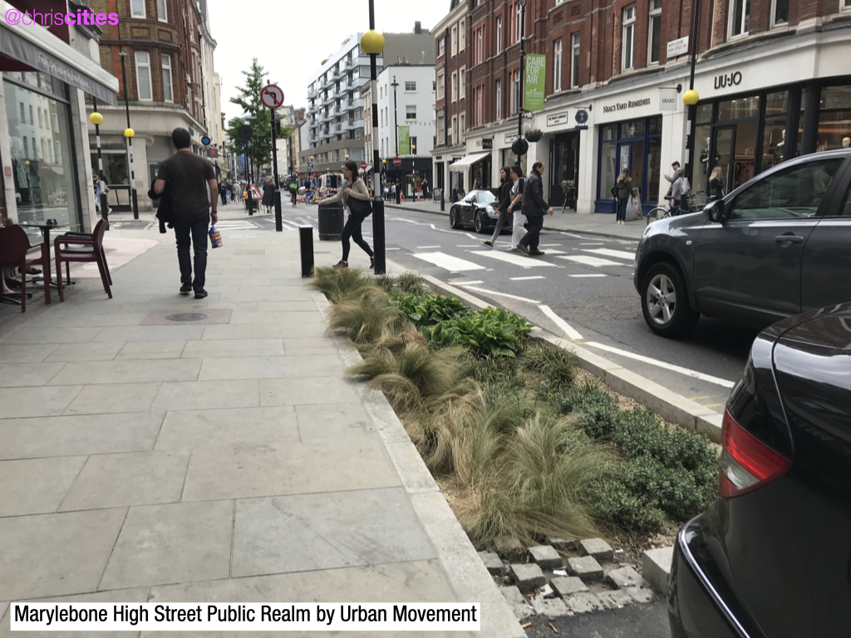
Notes:
Investment in streets can - and must - help us better manage surface water - reducing flooding - and protecting habitats - seeing water as an asset - rather than an inconvenience to hide.
This is how we green streets - increase biodiversity and habitat - and help protect our oceans and waterways. The sea starts on our streets.

Slide 5
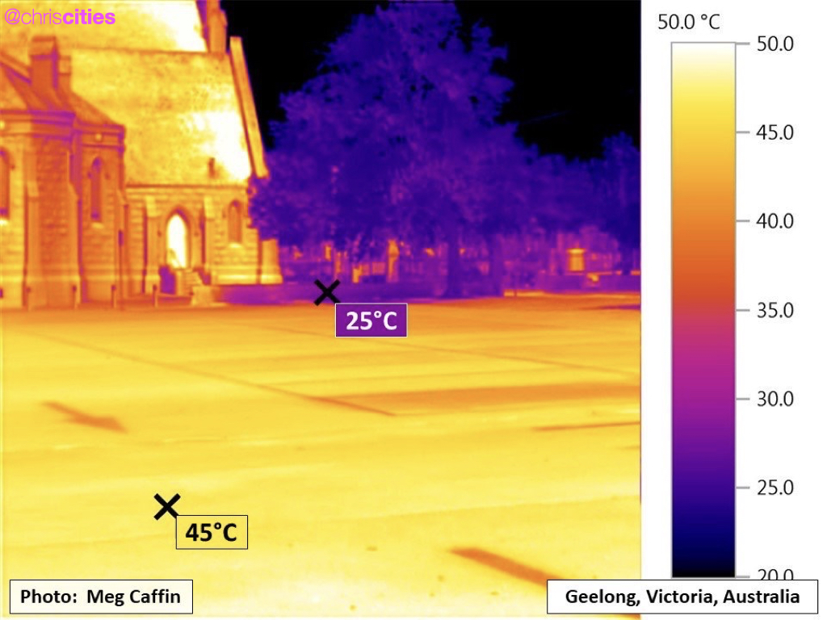
Notes:
the summer of 2022 entered the climate record books - as the first time that the UK hit an air temperature above 40 degrees C.
As you’ll no doubt remember - The heat was not confined to the daytime - with the UK also breaking its high summer minimum temperature.

Slide 6
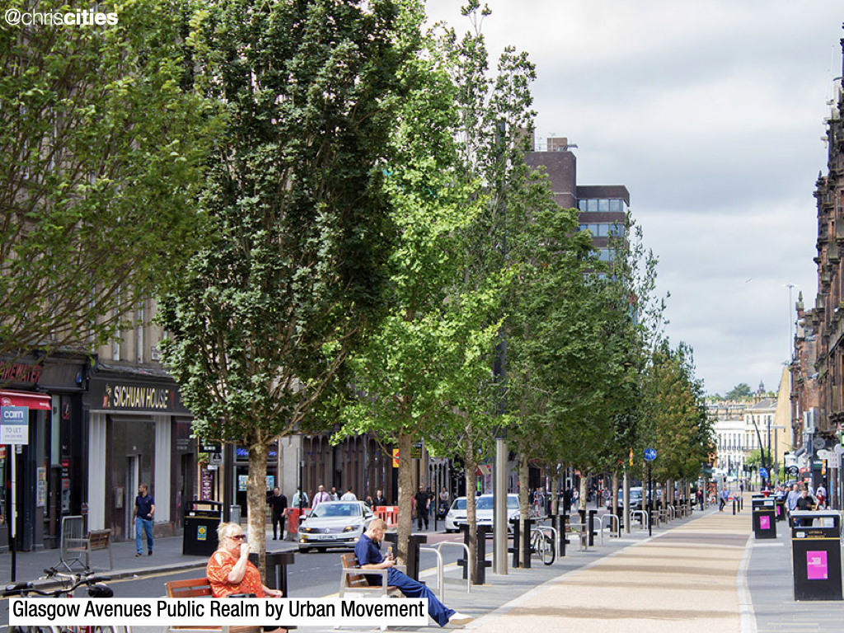
Notes:
We need investment in streets - to target the urban heat island effect - to make cities and urban areas - better places to live - and places we can continue to live.

Slide 7
Notes:
The places we have created for human beings to live in - are not great for our mental heath. 55 per cent of Londoners - say they feel lonely sometimes - and in other UK cities - 15% of people say they feel they have absolutely nobody to rely on.
But we know how streets can address this - Donald Appleyard highlighted - the increased social connections we have - when our residential streets especially - are not dominated by through-traffic - and aren’t a barrier.

Slide 8
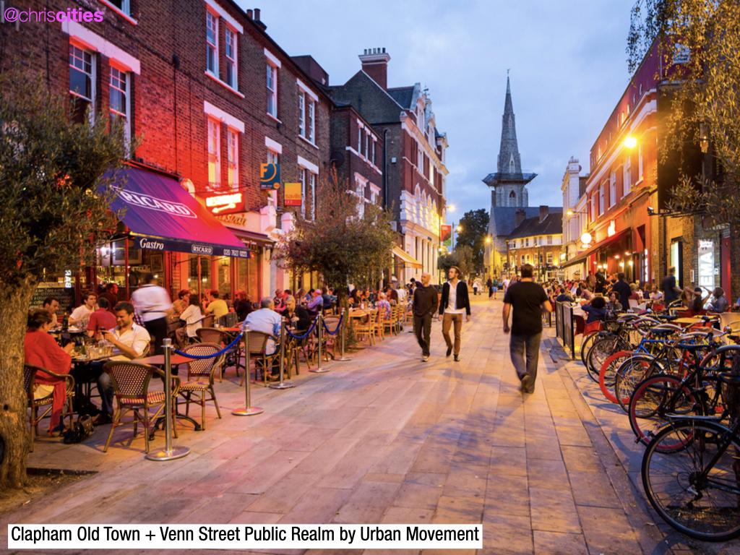
Notes:
Streets need to continue to be the democratic heart of communities and neighbourhoods - to fight urban loneliness - and support the conviviality principle.
Some cities have always been laid out following a conviviality principle - towns and cities in Spain and Italy with their many Piazzas spring to mind - but others have had to work hard - and set aside more and more space for citizens to come together.
Often this is a matter of reclaiming space - that has for too long been dominated by traffic - and making this space where people can come together - allows us to be social - to be human.

Slide 9
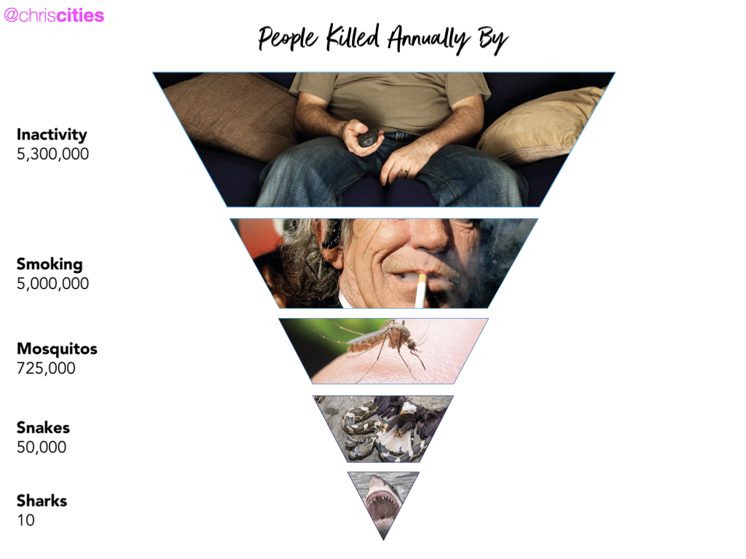
Notes:
We need investment in our streets to enable active travel - there are too many reasons for this to talk about right now - but for one because inactivity is killing over 5 million people EVERY YEAR globally - and ruining many more lives.

Slide 10
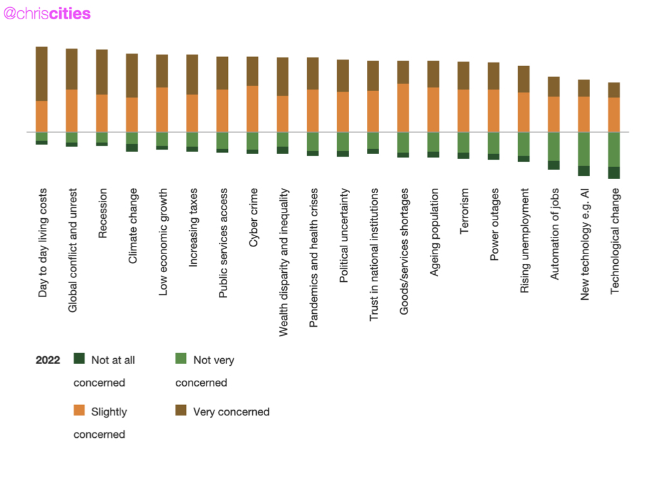
Notes:
Investment in streets needs to tackle the affordability crisis.
In the last quarter of 2022 - 86% of UK adults said they were concerned about day-to-day living costs.
And at that time - the average cost of owning a car was £3,406.80 a year in the UK – or £5,744.40 for those with car finance.

Slide 11
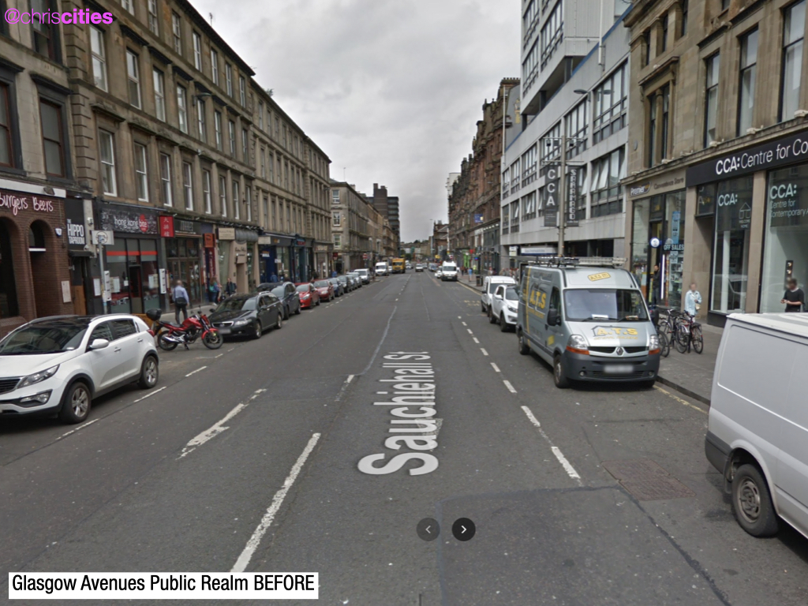
Notes:
Yet our streets and neighbourhoods on the whole - require people to drive - to access opportunity - leisure and essential services.

Slide 12
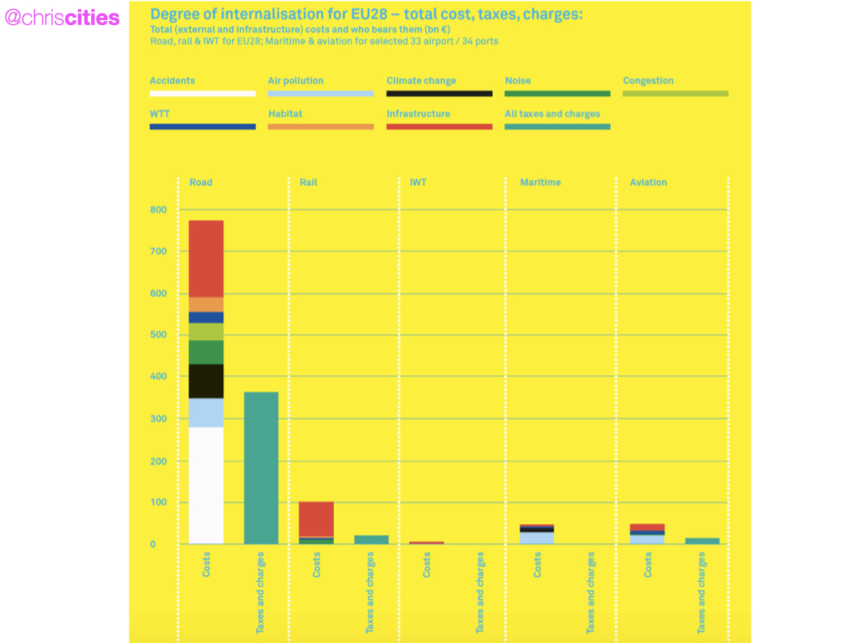
Notes:
and this through the lens that every man, woman and child - whether they drive or not - is subsidising car use - to the sum of £800 a year.

Slide 13
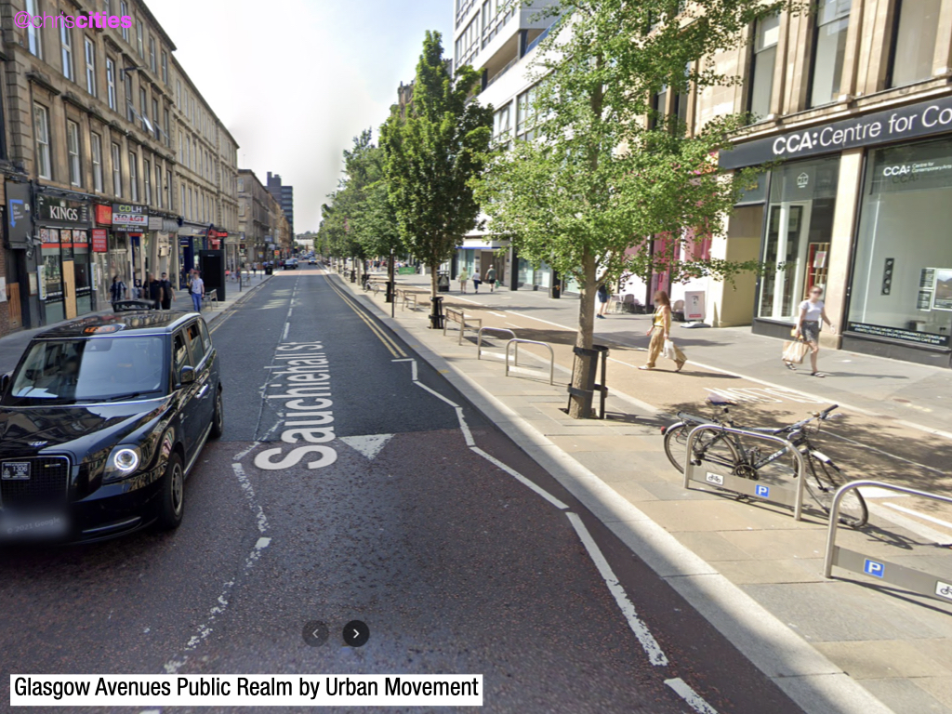
Notes:
And with around 20% of people in the UK having no access to a car - our streets need to eradicate transport poverty - and make sure that everyone has access to opportunity in their lives - and that access cannot be predicated on owning a car.

Slide 14
Notes:
We need investment in streets to yield economic benefits - for our neighbourhods and struggling high streets.

Slide 15
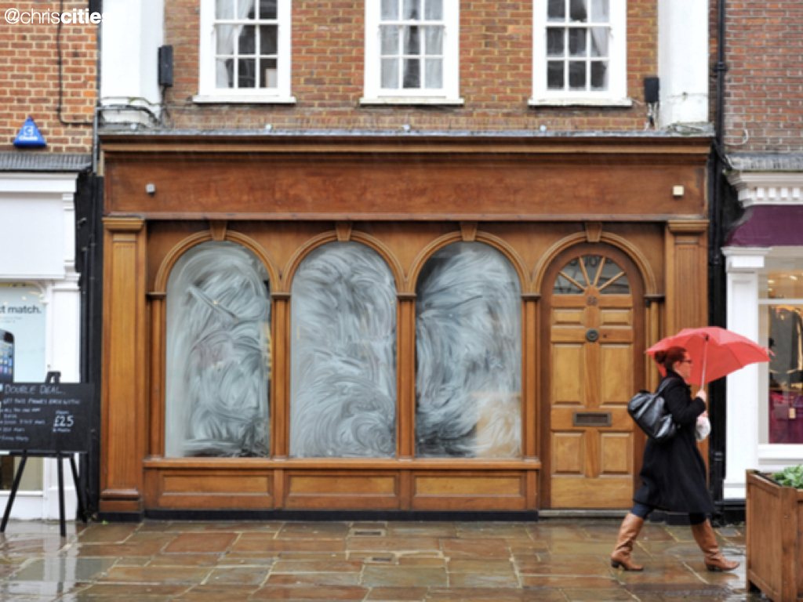
Notes:
In the third quarter of 2022 - the overall vacancy rate in UK High Streets was 14%.
We know Better streets - make for better places to spend time and money.

Slide 16
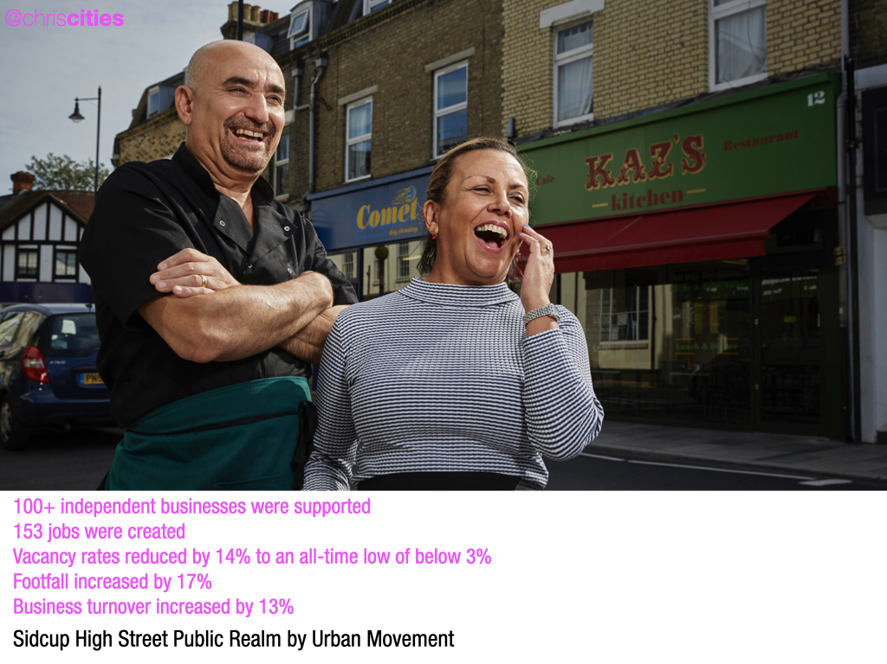
Notes:
and we know when more space is given over to people - for spending time, walking and cycling - and less to cars - the absence of customers arriving by car - is more than compensated - by people arriving on foot or by bike - if we get the design right.
For example - in San Francisco - the first trial ‘parklet’ increased pedestrian traffic in the area by 37% on weeknights - and increased people walking at the weekend by 350%.
A similar scheme in London, increased takings in an adjacent shop by 20%.

Slide 17
Notes:
The case for designing streets, and transport networks to yield better outcomes for quality of life - environment - and economy is clear - but it’s not that simple.
The places we have already designed - have created the culture in which we live - because places shape our behaviour - and behaviour over time - becomes our culture.
So when we - as the public - hear about change - we get very heated - because we see it as an attack on our culture - and this is what we’ve seen a lot in the media of late - and you’ve seen your fair share of this here.

Slide 18
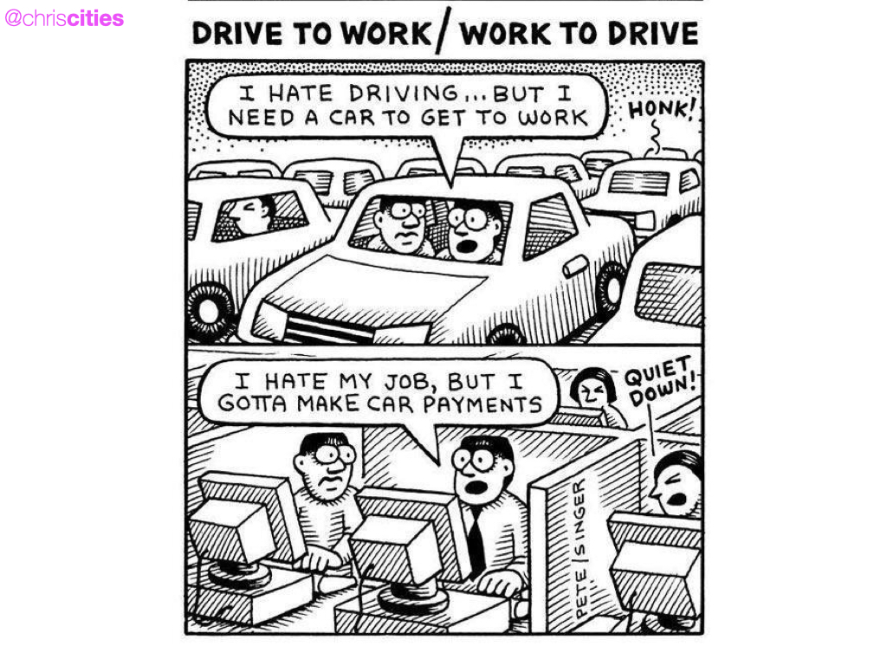
Notes:
And I think a key takeaway - is that If you live in a place that affords an enormous choice in the ways in which you can move about - to do what you need to do - likely you are not a driver - not a walker - not a cyclist. Transport does not define you.
Sometimes - doing what I need to do - I choose to drive - sometimes I choose to cycle - and most of the time I choose to walk - however in this - my choices do not define me as a person. Because - I have choice.
When we don’t have a choice - we’re very protective of what we have - because without it - we are stuffed - so it starts to define us.

Slide 19
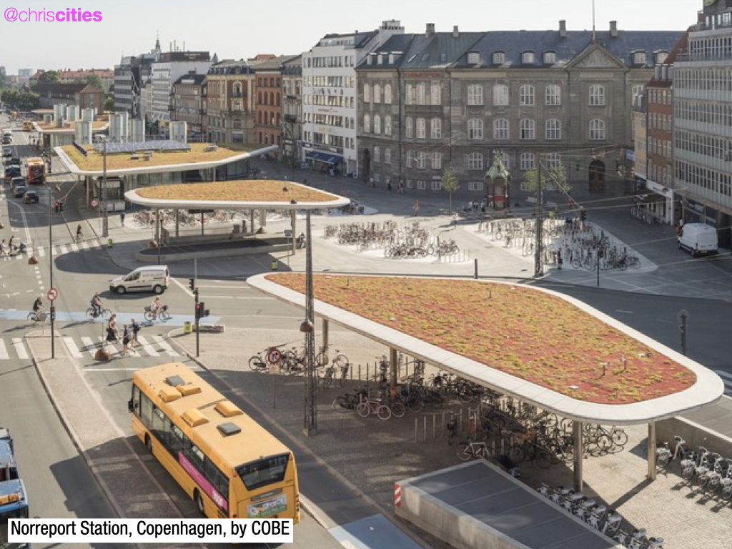
Notes:
CHOICE. This is what unlocks opportunity in transport.
Investing in rail - investing in cycling - in enabling children to walk to school - and connecting it all up - this unlocks choice - unlocks opportunity - eradicates transport poverty.

Slide 20
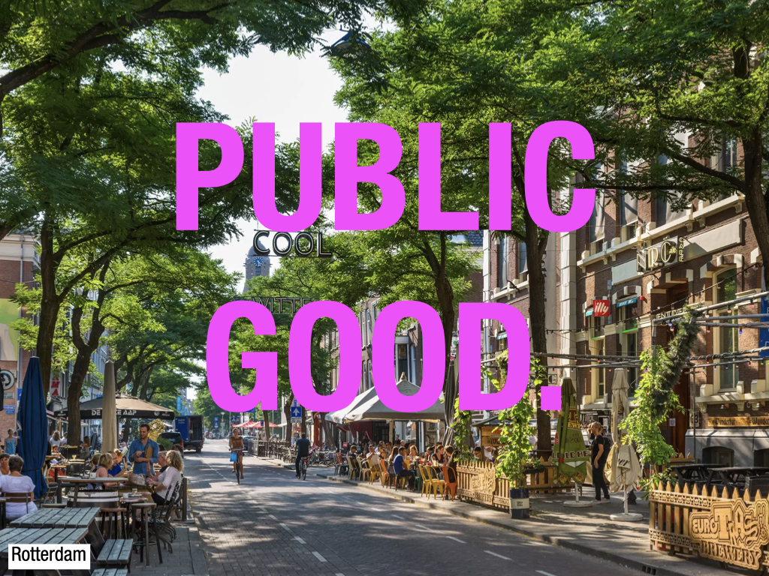
Notes:
Looking forwards - we need to view our streets and transport systems - as the valuable assets they are - to move away from nostalgic or learned behaviours and views of what streets are - and ensure that streets are delivering - a public good - at the very least.
And we must not see this public good as a cost - to be negotiated away once planning permission has been obtained - or concept designs supported - It should be the benchmark that all new developments - and all streetscape projects - should meet.

Slide 21
@chriscities
Too much traffic, and traffic travelling too fast
Road danger concerns
Personal security concerns
Streets are not pedestrian friendly
50% under 3km
Main barriers to walking more
Walking in London, TfL
Who travels by car in London
and for what purpose?
Roads Task Force – Technical Note 14
Notes:
Extending choice to more and more people - is a public good - but by the same token we cannot objectively look at journeys that are eliminating other choices for people - and not act.
And this is the genus of area based traffic management interventions.
We know what the barriers to walking short journeys are for instance - and a lot of these are centred on the fact there are too many vehicles making those short journeys - so we have to give people better choices to go about those shorter journeys - in ways that are better for everyone - and deliver a public good.

Slide 22
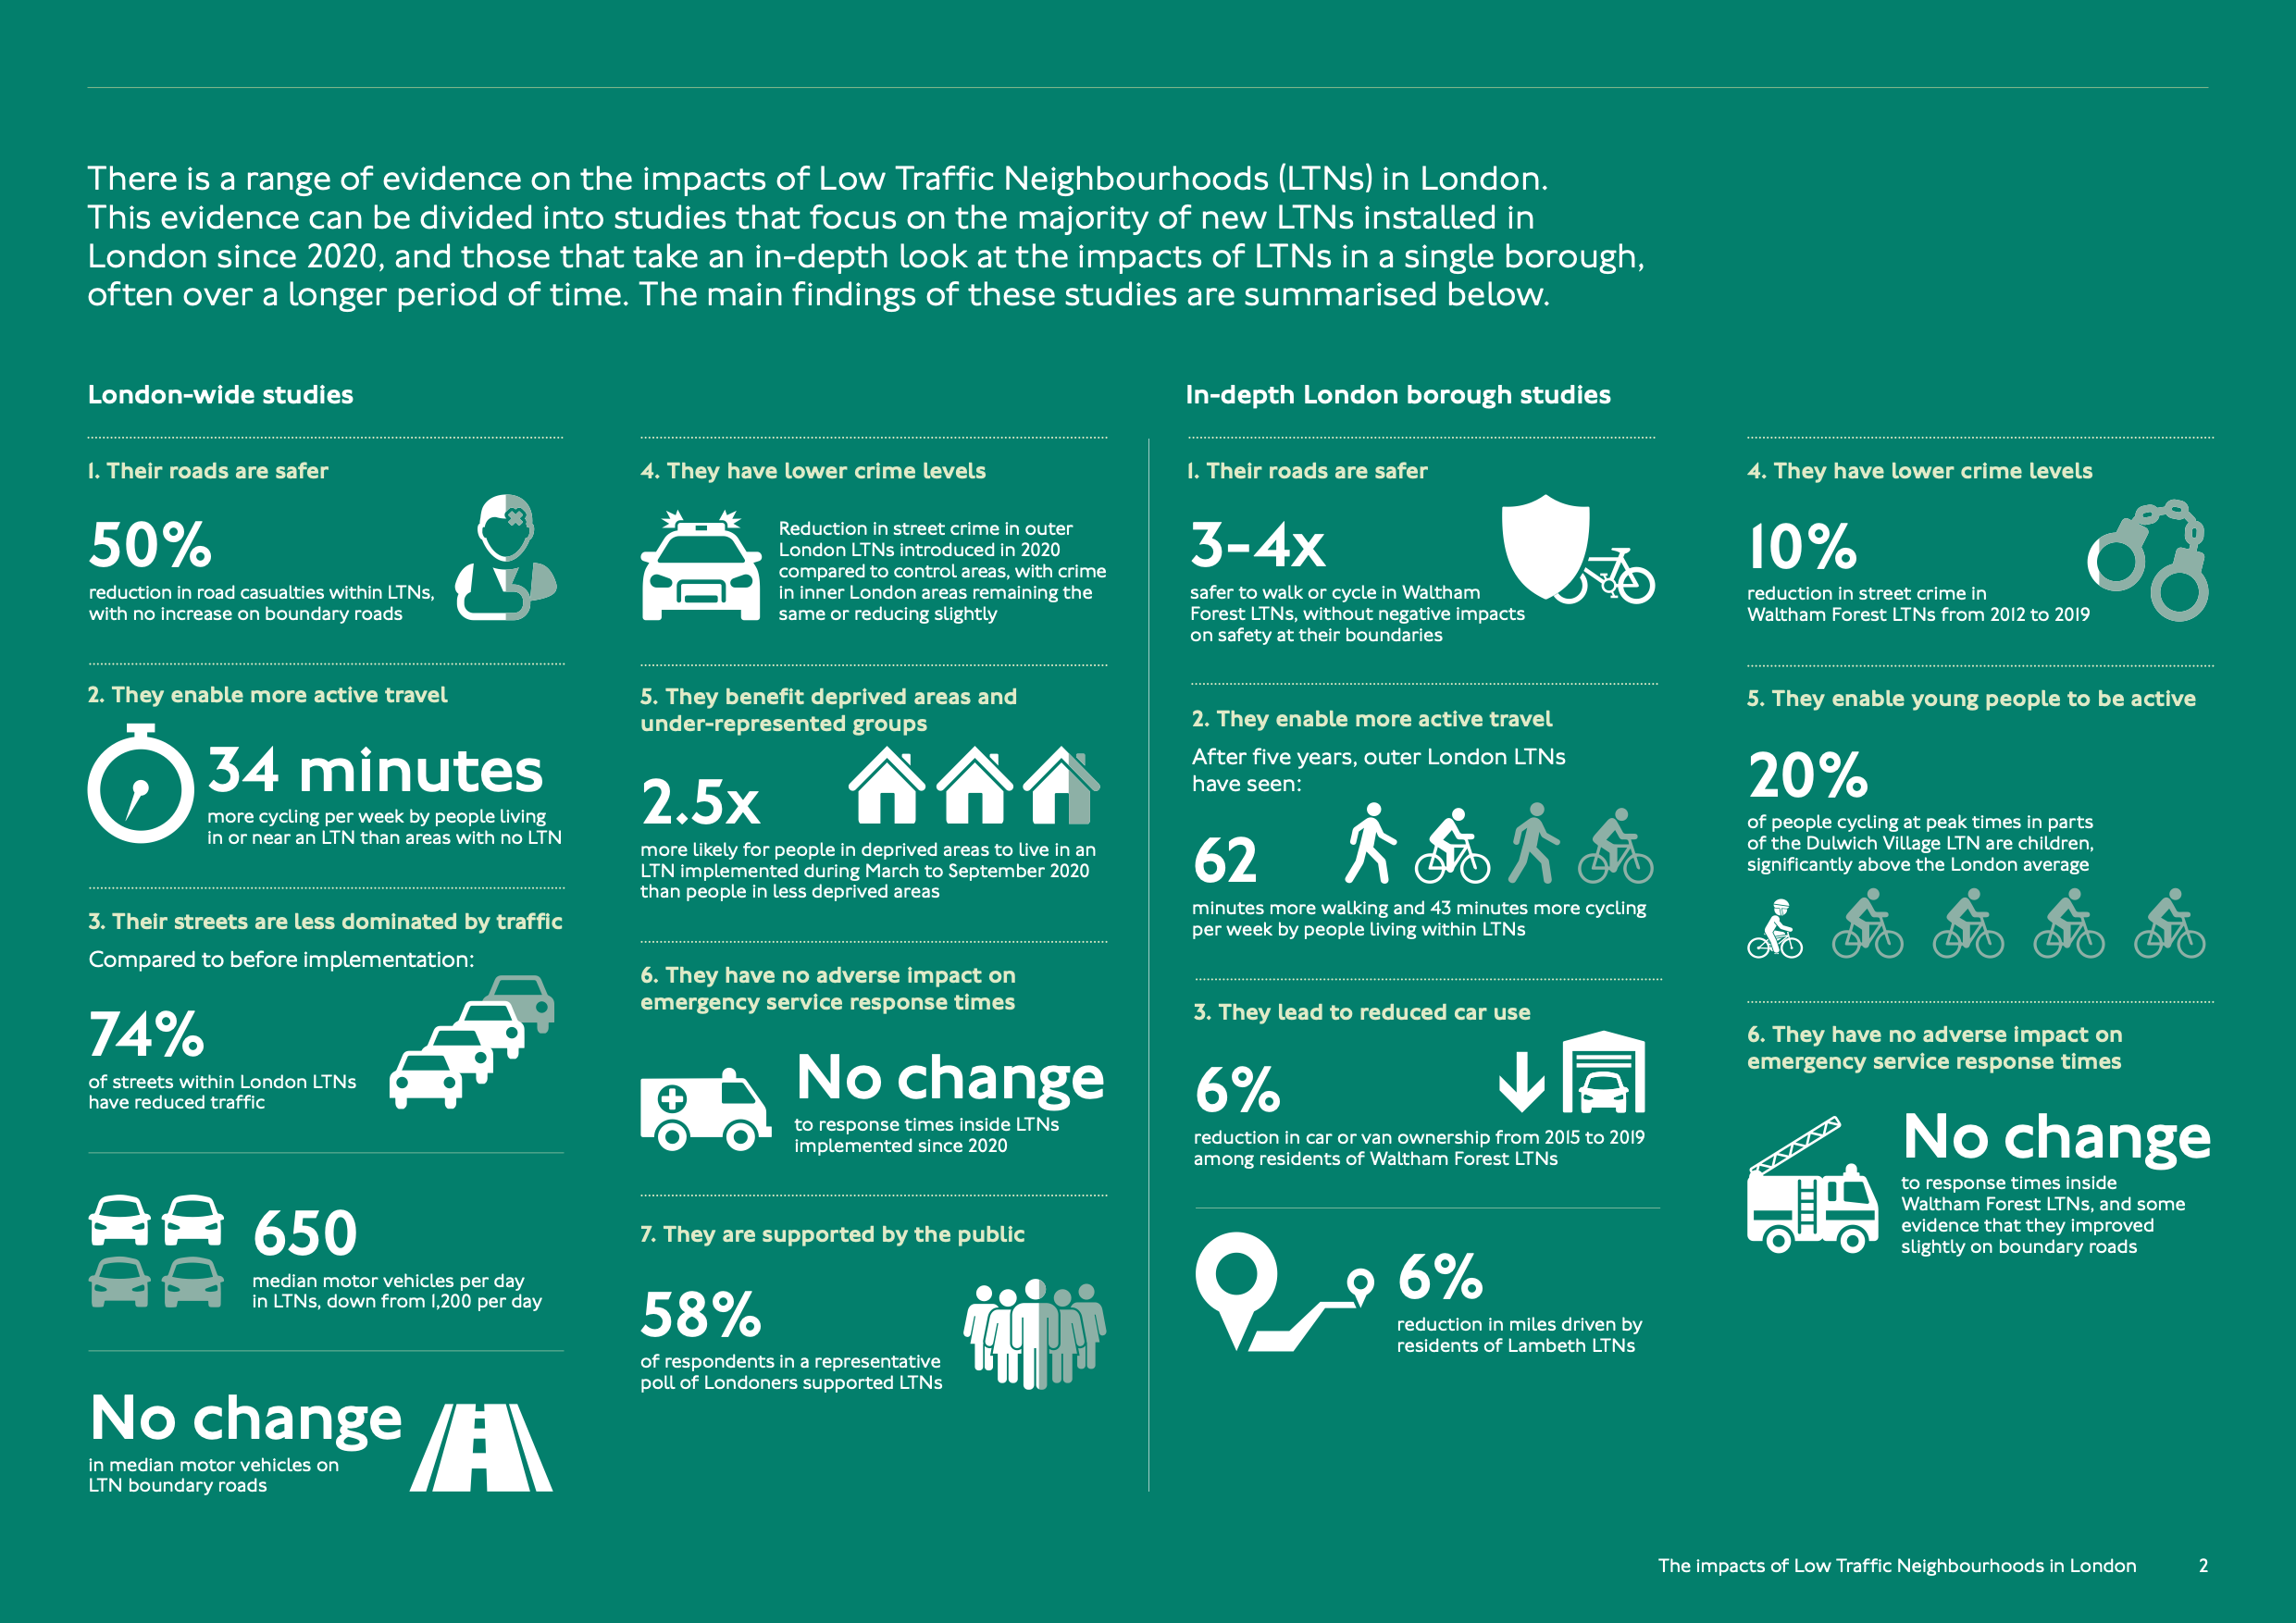
@chriscities
Notes:
And Looking at London’s LTNs - these have been focussed at doing just this - delivering a public good.
There is a range of evidence on the impacts of Low Traffic Neighbourhoods (LTNs) in London - developed by TfL - and the evidence is divided into studies that focus on the majority of new LTNs installed in
London since 2020 - and those that take an in-depth look at the impacts of LTNs in a single borough - often over a longer period of time.
This in depth study found that streets were safer - with fewer casualties and collisions within LTNs and on boundary roads. Transport choice was unlocked for more people - with more people choosing to walk and cycle if they live near or in an LTN.
This transport choice - manifested in more people deciding they no longer needed to own a car - helping with the affordability crises and reducing transport poverty.
And also - unlocking more transport choice for young people - has seen them move about in more active ways - compared with those without choice - and the impacts of this on health are huge.
The data supports the need for us to design in more choice - for people. To make transport a servant to our quality of life.

Slide 23
Notes:
But in this we also have to think about designing for human behaviour - and designing for people to whom this is going to be alien - be viewed as an attack - and who are going to seize every opportunity to attack you - if it’s not great.
We - as human beings - have self interest. So we must design for this otherwise we won’t be able to enact change.
And this is the key as far as I am concerned. How do we connect self-interest - and public good?!
HOW do we get someone - who defines themselves as a mode of transport - to try something else?

Slide 24
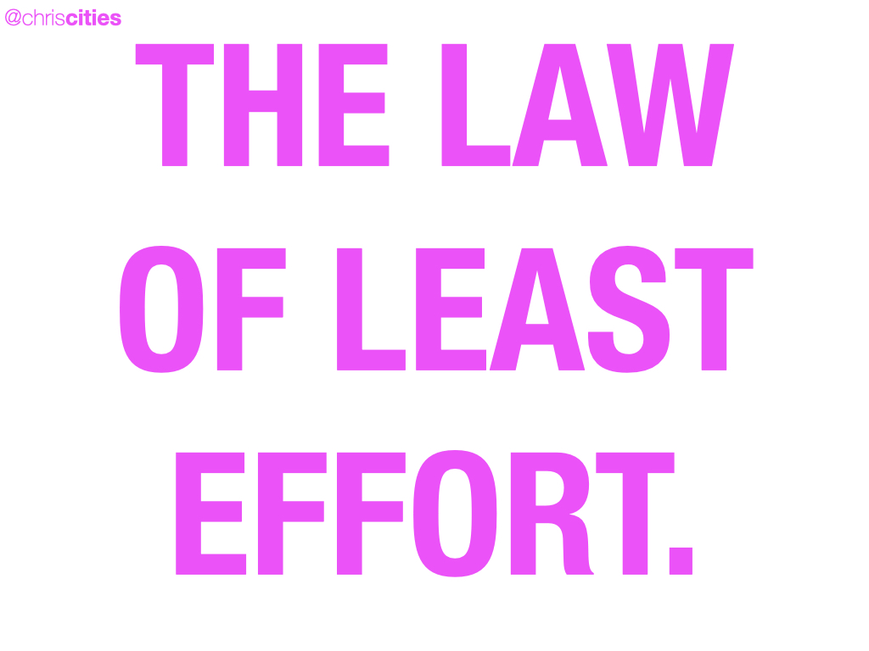
Notes:
Human beings are governed by the “Law of Least Effort”. The law asserts - that if there are several ways of achieving the same goal - people will eventually gravitate to the least demanding course of action.
Laziness is built deep into our nature.

Slide 25
Notes:
But by the same token - we also seek out joy and fun - SO - we must harness this power of hedonism - for good - And Develop our streets - towns - cities - and transport systems - around an idea of Hedonistic urbanism.
Hedonistic urbanism is making what is good for the planet - good for people - and good for cities - the most enjoyable - the most fun - and the most self-indulgent option - so we queue up for it.
This is a design principle - and a challenge for us as designers - it has to look right - it has to work - it has to feel right - and it - has - to - be - easy - Seamless.

Slide 26
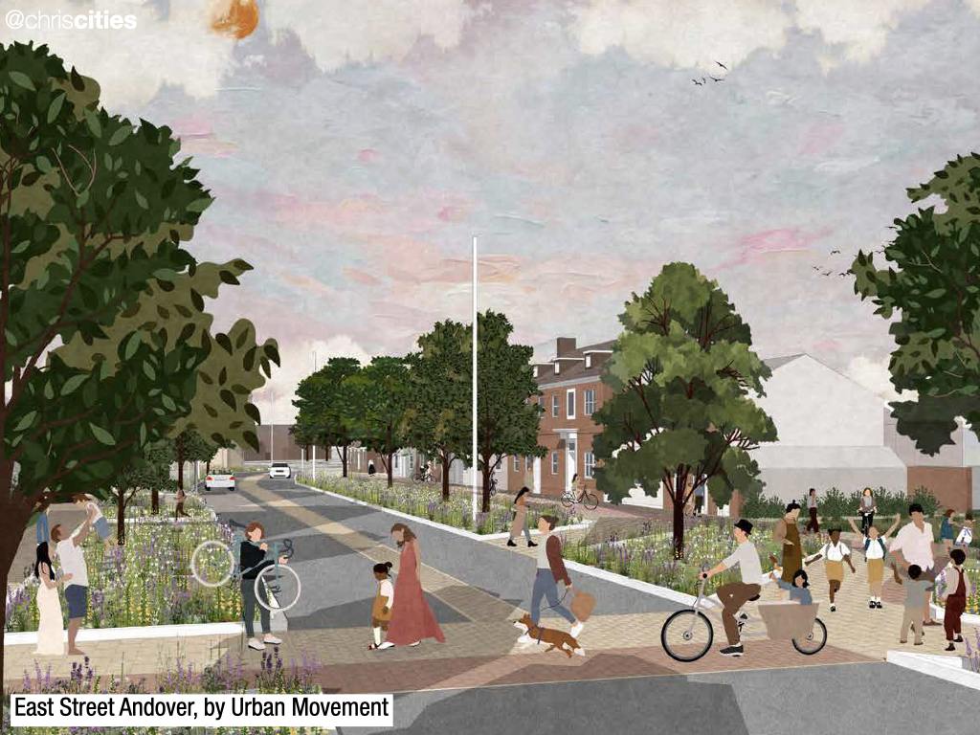
Notes:
To add another layer of detail I would like to talk about 3 different street typologies for designers.
Again we have to view these through the lens of movement and place - but firstly - Designing for movement has often been the main focus of government and the profession - but place is of great - if not greater - importance when considering accessibility and inclusion.

Slide 27
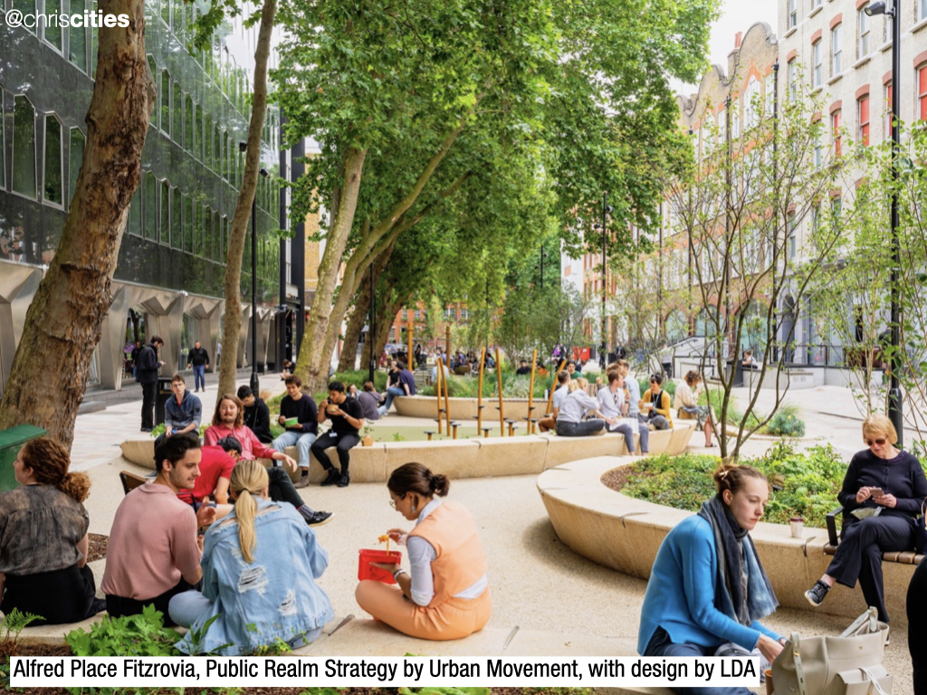
Notes:
As well as this - and moving beyond movement and place - we have to understand the scale of contribution that good street design - can make to achieving better places.
Highway and transport networks - particularly in built-up areas - account for a significant proportion of the public realm - and fulfil a range of vital functions - alongside their movement function.
The fundamental thread in design, maintenance and operation - of the highways and transport networks - should be that the needs of all users are considered - to create an inclusive public realm.

Slide 28
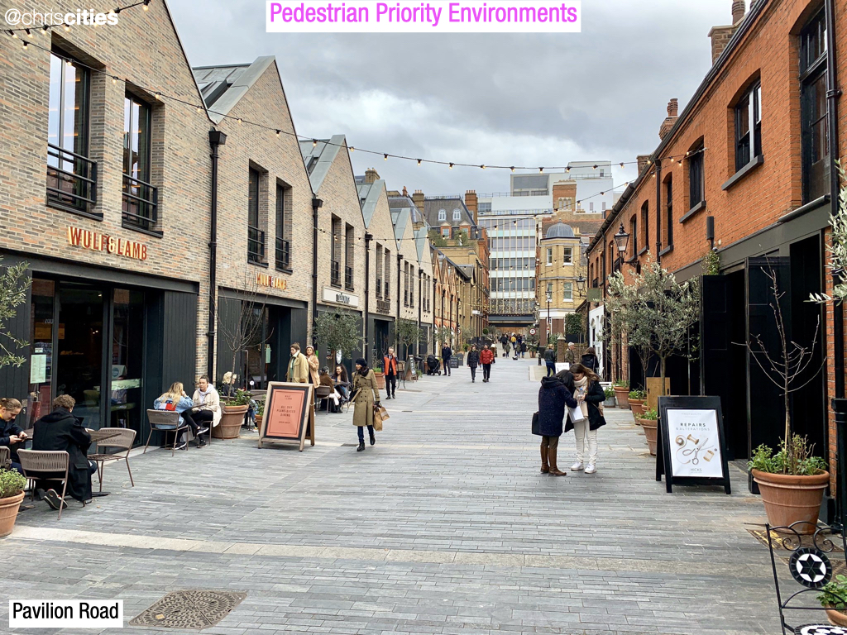
Notes:
SO onto the street types.
This type of street - a pedestrian priority street - aims to create the conditions whereby drivers and riders - feel they should give priority to pedestrians - and where pedestrians feel comfortable in accepting that priority - and that means we have to create the conditions where there are few vehicles - and those that there are - are moving slowly - with cyclists using the carriageway - or movement zone.
We do not need a well-defined carriageway - so that road users (particularly drivers) - do not assume that pedestrians need a defined crossing - or a driver’s permission to cross the street.
Seating, informal play, tables and chairs - and other useful street furniture - should be placed in the street - to emphasise its primary function as a place to be enjoyed - as well as creating a clearly defined safe zone - for blind and partially sighted users.

Slide 29
Notes:
This second design approach should be used to create a street - where a higher volume of traffic - does not dominate the experience.
Design features - for reducing vehicular speed and dominance - are reducing the differentiation between the footway and carriageway - using reduced-height kerbs - and providing features such as median strips to encourage more frequent crossing.
Also - the legal minimum amount of road markings should be used - and the provision of regular crossings.

Slide 30
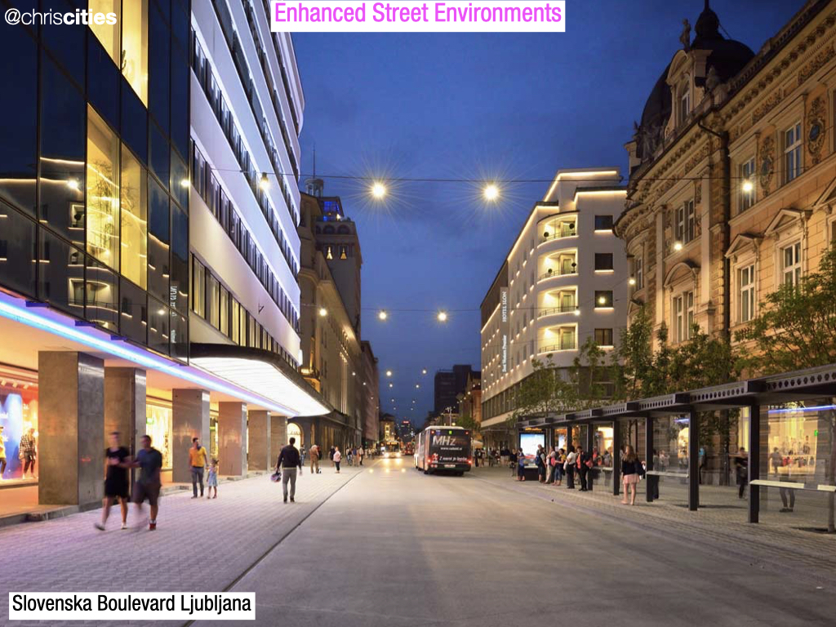
Notes:
Finally - The enhanced street type is essentially a conventional street - where care has been taken to improve the quality of the place.
This is typically achieved through the removal of unnecessary street clutter - especially pedestrian guardrails - which reduce people’s freedom of movement - and with the introduction of features such as seating, public art and street trees - to improve the experience of simply being there.

Slide 31
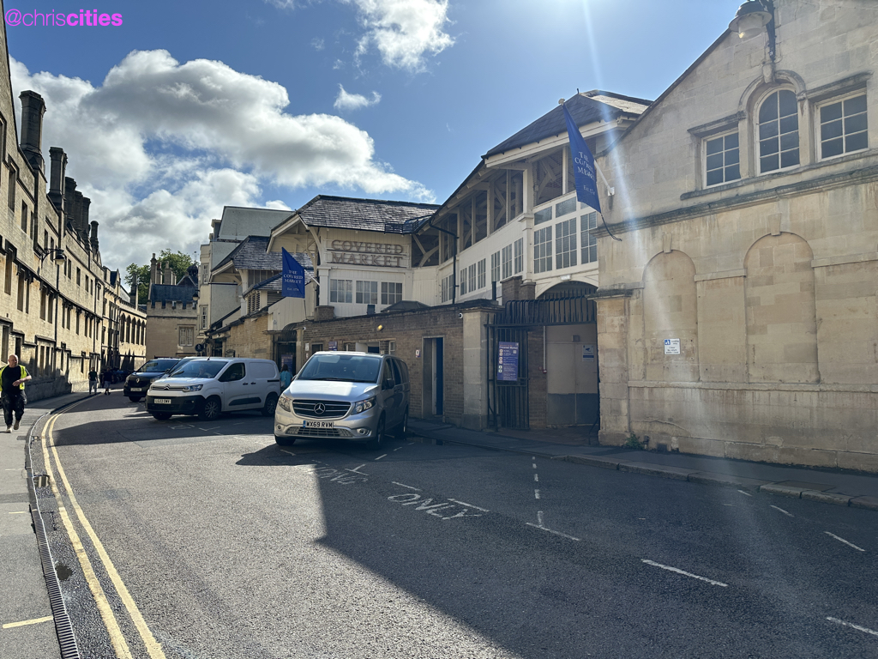
Notes:
And through that lens - let’s look in detail at the proposals for Market Street.

Slide 32
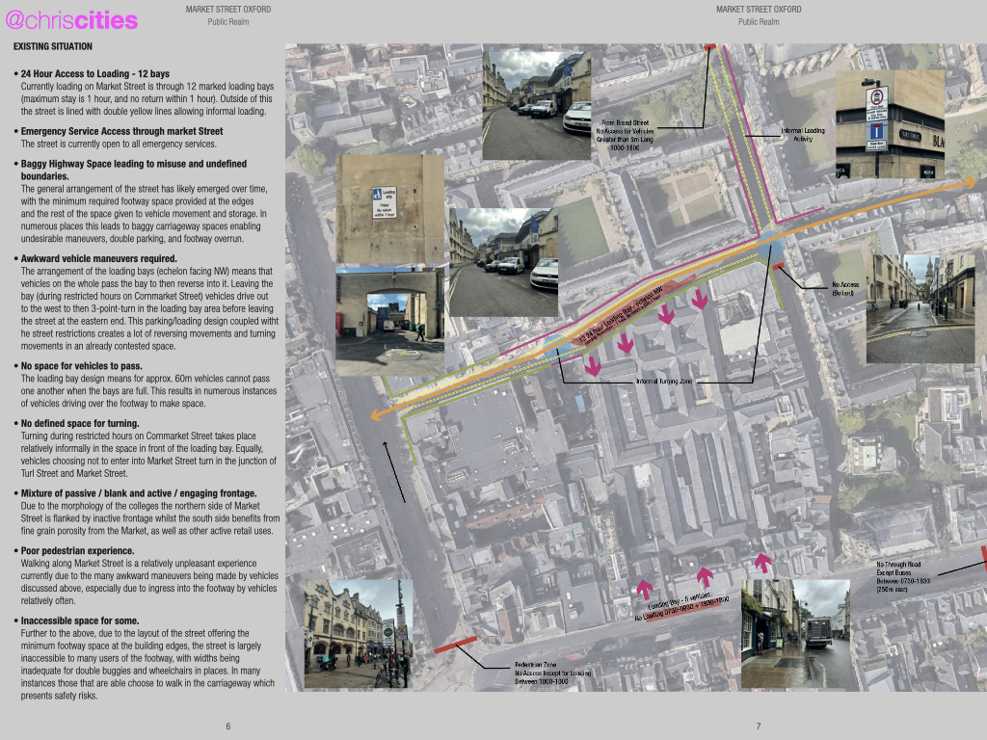
Notes:
a

Slide 33
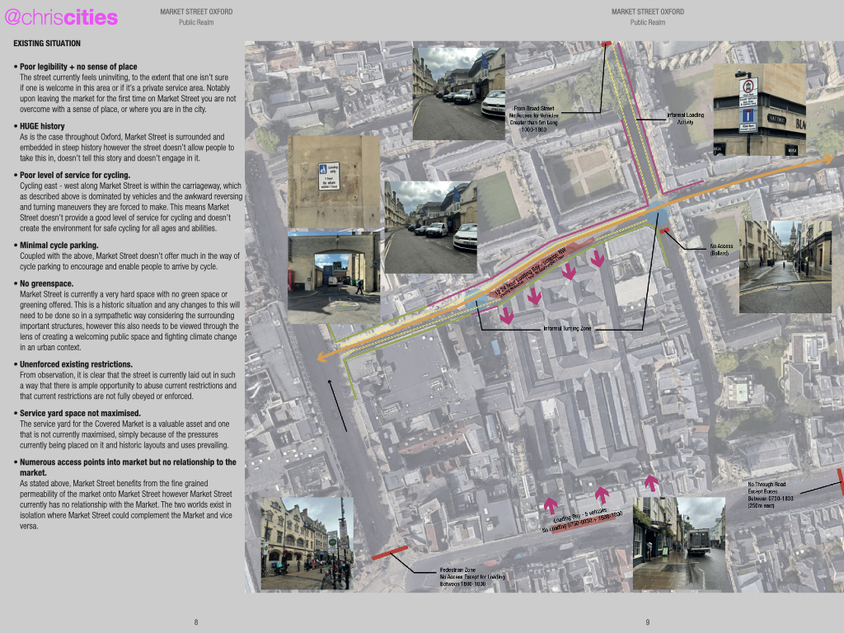
Notes:
aa

Slide 34
Notes:
aa

Slide 35
Notes:
aa

Slide 36
Notes:
aa

Slide 37
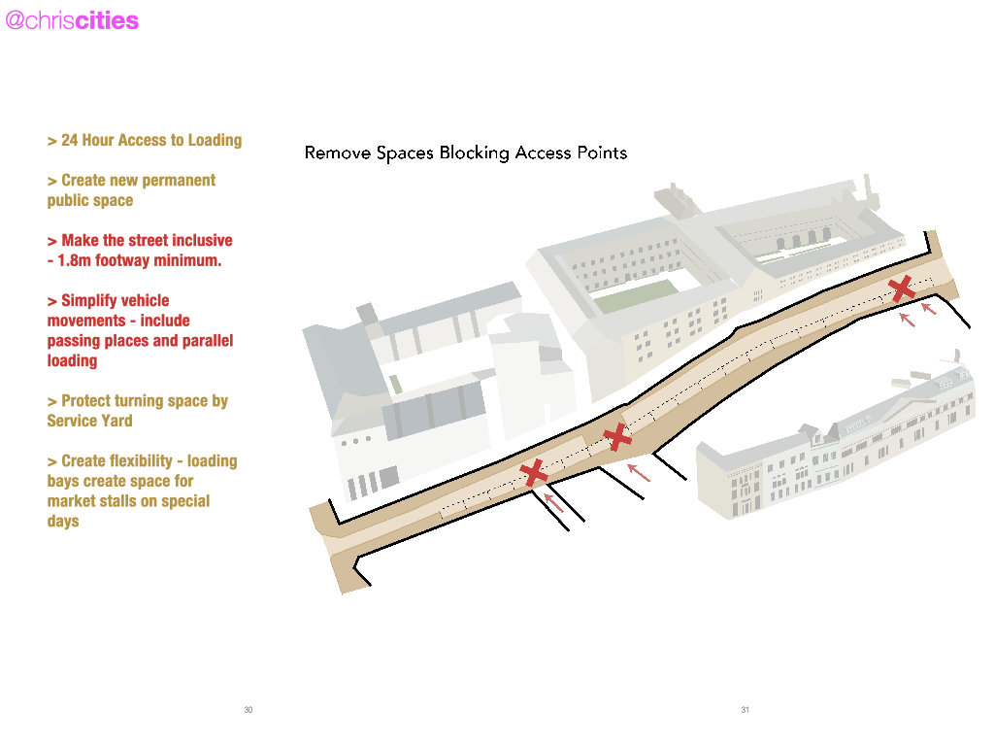
Notes:
aa

Slide 38
Notes:
aa

Slide 39
Notes:
aa

Slide 40
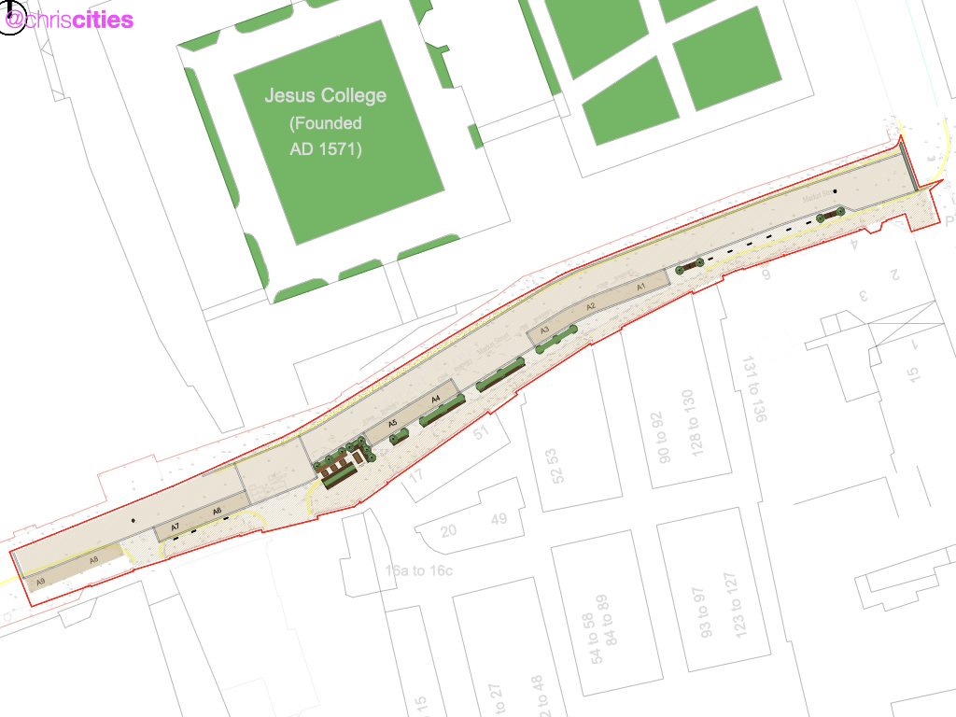
Notes:
aa

Slide 41
Notes:
Thank you.

