Slide 1
The ABC of BNG Peter Massini Director, Future Nature Consulting

Slide 2
Why is Biodiversity Net Gain being introduced?
There has been a steady decline in biodiversity (wildlife and natural habitats) across the country since the 1970’s.
Much of this is a consequence of the intensification of agriculture, but development often results in the direct loss of existing habitat often with limited mitigation.
Parliament passed the Environment Act in 2021 which, amongst other things, included the introduction of mandatory Biodiversity Net Gain (BNG) with the intention to ensure that….
…development will result in more or better-quality natural habitat than there was
before development.
Notes:
Peter

Slide 3
What is the purpose of Biodiversity Net Gain (BNG)?
To help deter new development from damaging or degrading existing wildlife habitat.
To encourage biodiversity to be considered from the outset of the development process.
To create or enhance wildlife habitats on-site or off-site to compensate for any losses…
… and achieve an overall net gain of at least 10%.
Notes:
Peter

Slide 4
When does BNG become mandatory?
12th February 2024 - for most development subject to the T&CPA 1990.
2nd April 2024 - for ‘small sites’. < nine units and/or 0.5ha
2025 for Nationally Significant Infrastructure Projects (NSIPs).
It will be applied through attachment of a general planning condition when planning permission is granted:
“No development shall commence until a Biodiversity Net Gain Plan has been approved by the local planning authority.”
Notes:
Peter

Slide 5
Are there any exemptions?
Householder development as defined within Town and Country Planning (Development Management Procedure) (England) Order 2015, and permitted development rights.
Development where existing habitat is less than 25 square metres, or 5 metres of linear habitat such as hedgerows.
Self-build and custom build development as defined in the Self-build and Custom Housebuilding Act 2015 on small sites.
Notes:
Peter

Slide 6
How is BNG calculated?
It is the difference between the value of habitats on site prior to development¹ (i.e. the baseline biodiversity value) and the value of the habitats on-site (and/or off-site) after development, plus at least 10% (i.e. the post-development biodiversity value).
The value is measured in terms of ‘biodiversity/habitat units’ which are calculated using a Statutory Biodiversity Metric (or a simpler version for small sites).
The baseline biodiversity value is determined by factors such as: habitat type, its ‘distinctiveness’, its area, its condition, and its ‘strategic significance’.
Post-development biodiversity value is determined by the same factors, plus: the time habitats take to achieve their target condition, whether habitats are created in advance of or after development, and, for offsite habitats, their proximity to the development site.
Notes:
Peter

Slide 7
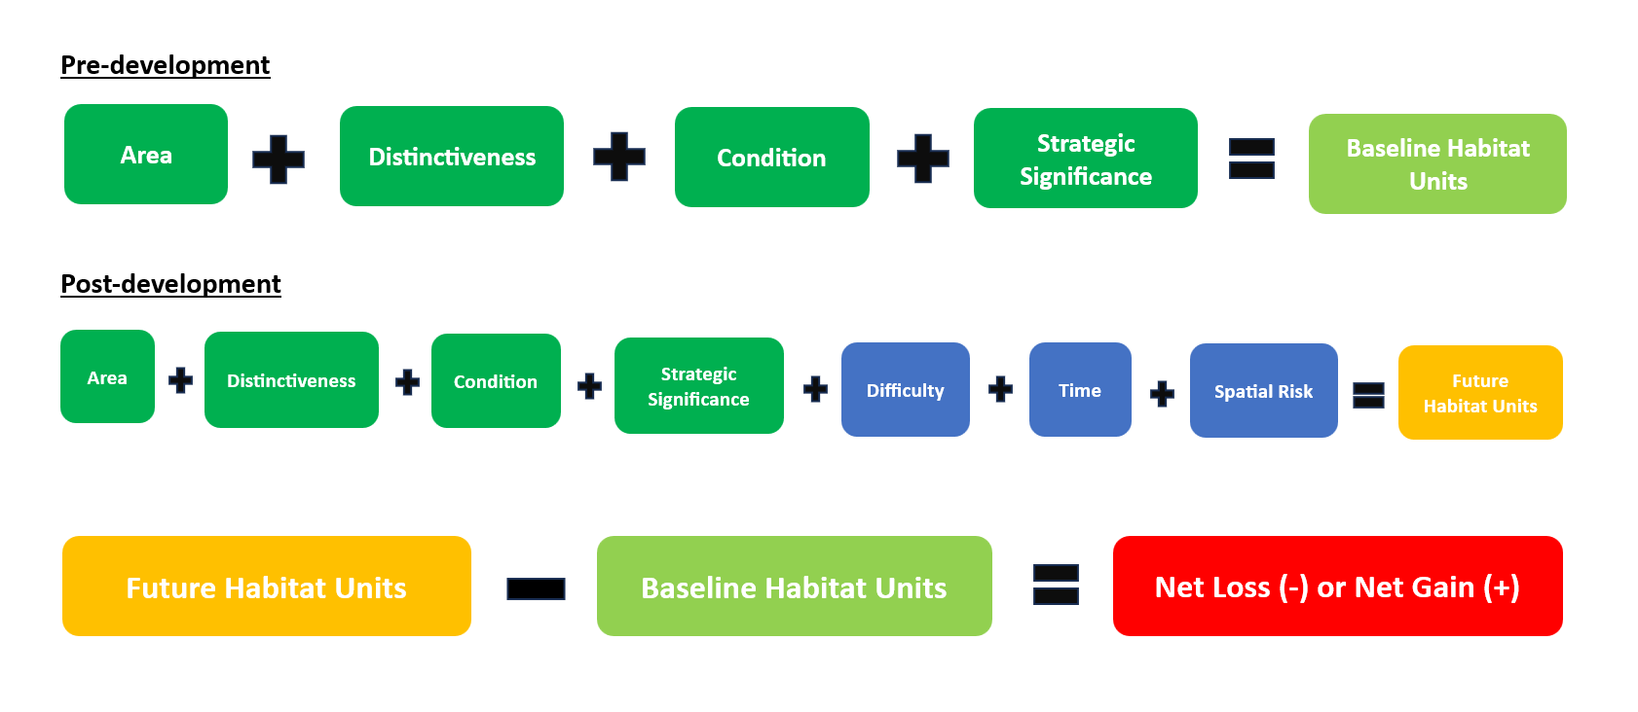
Notes:
Peter

Slide 8
Term | Definition | How recorded
Area | The area of the habitat parcel to be retained, enhanced, created, or lost. Size is measured in hectares for area features, or in kilometres for linear features. | Direct measure
Distinctiveness | The ‘value’ of the habitat i.e. takes into account rarity, species richness, and the degree to which a habitat supports species rarely found in other habitats | Pre-determined in metric – five grades from Very High to Very Low
Condition | A measure of habitat quality against its ecological optimum state. A way of measuring variation in the quality of patches of the same habitat type | Choose from menu – five grades from Good to Poor
Strategic Significance | A measure of whether the location of the habitat is ecologically important according to relevant strategies | Choose from menu – three grades depending on strategic habitat mapping
Time to condition | The number of years taken between starting creation or enhancement of habitats and when it is likely to reach its target condition | Pre-determined in metric - penalty for habitats which develop over long period
Difficulty | A measure of the uncertainty in the effectiveness of techniques used to enhance or create habitat. | Pre-determined in metric - penalty for trickier habitats
Spatial risk | The relationship between the location of biodiversity loss and where the off-site habitat is being delivered. (Factored into off-site calculation only) | Pre-determined in metric - three tiers relating to whether inside or outside LPA (or NCA) boundary

Slide 9
What does 10% BNG actually mean?
It is important to realise that BNG is a measure of relative change from the baseline value.
Achieving a 10% net gain on a site with a very low baseline may actually require very limited habitat creation or enhancement, whereas delivering a 10% BNG on a site with extensive areas of semi-natural habitat could require very costly off-site compensation
Sites with a zero baseline (i.e. no existing vegetation or habitats on site) are effectively exempt from mandatory BNG…
…. because 0 x 10% = 0.
Notes:
Peter

Slide 10
How is BNG different from requiring a landscaping scheme?
The pre-development habitats are taken into account both with respect to retaining best features (if possible) or having to secure enhanced compensation for any loss.
Generally, the on-site ‘landscaping’ must be richer and more ecologically literate (unless the baseline is very low).
Offsite, or ‘significant’ onsite, habitats must achieve the condition specified and be managed and maintained for 30 years.
Notes:
Peter

Slide 11
What if it’s not possible to deliver BNG onsite?
A key element of the BNG approach is to provide new resources for creating or restoring natural habitats in the places where they will have most impact.
A market is being created in the provision of off-site habitat units whereby a developer can purchase units from an off-site provider to make up any shortfall if the on-site landscaping/habitat creation doesn’t achieve the 10% requirement.
In effect the off-site provider is creating a ‘habitat bank’ and is selling habitat units to the developer and taking on the liability for managing the habitats.
There is a recognition that ‘habitat banks’ may not be available locally until the market matures. In the interim, developers can purchase Statutory Biodiversity Credits . But these will be priced considerably higher than the market price.
Notes:
Peter

Slide 12
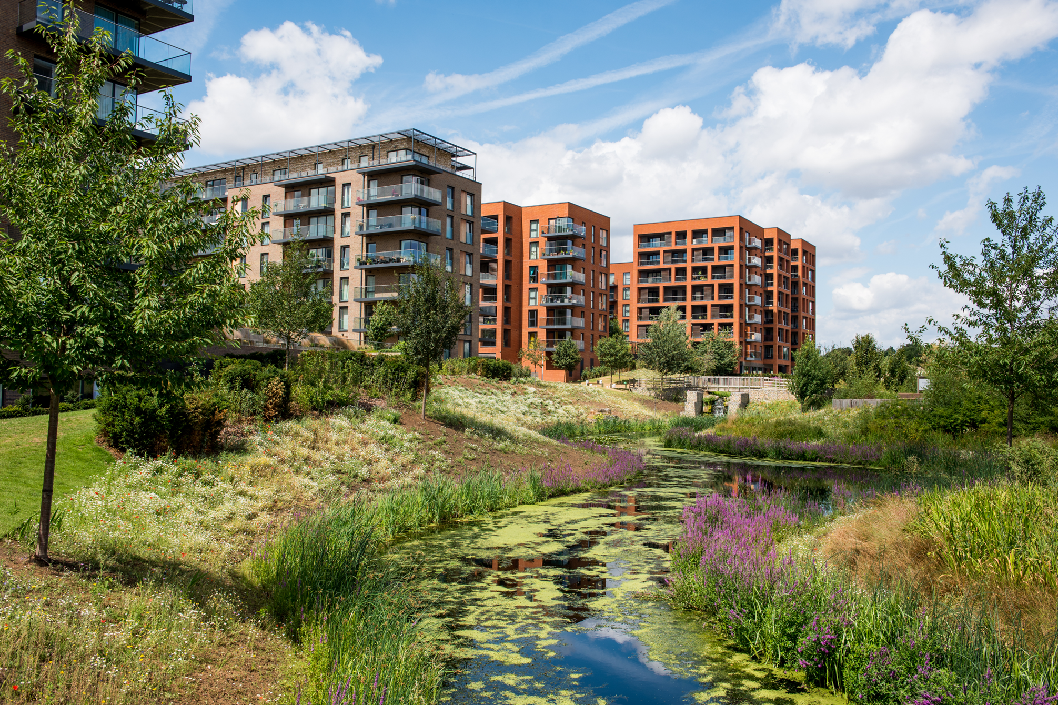

Slide 13
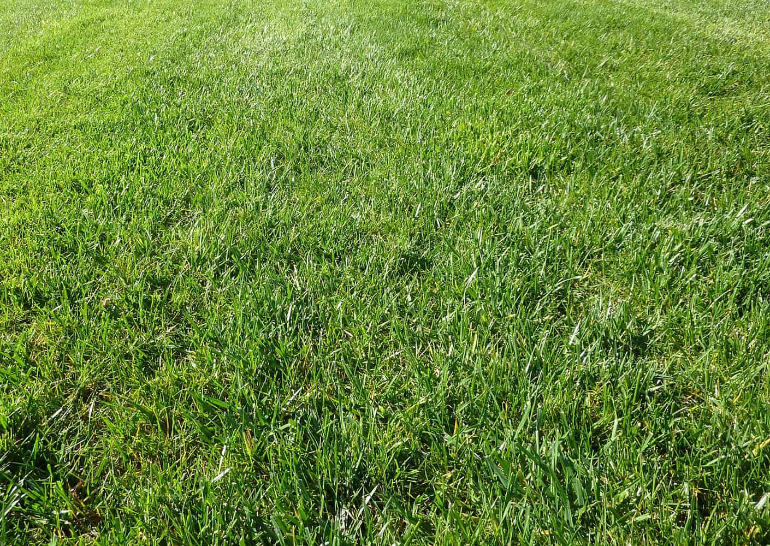
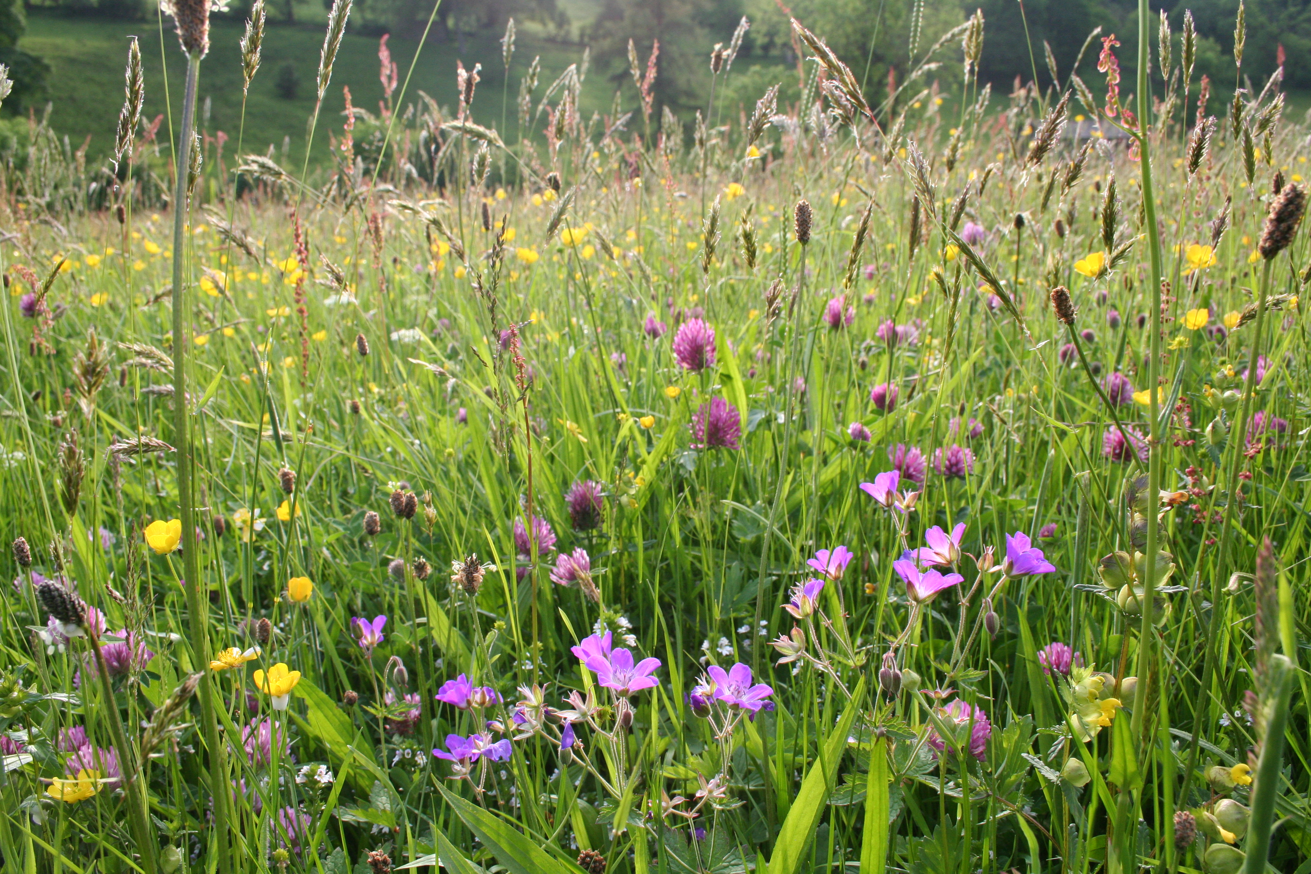

Slide 14
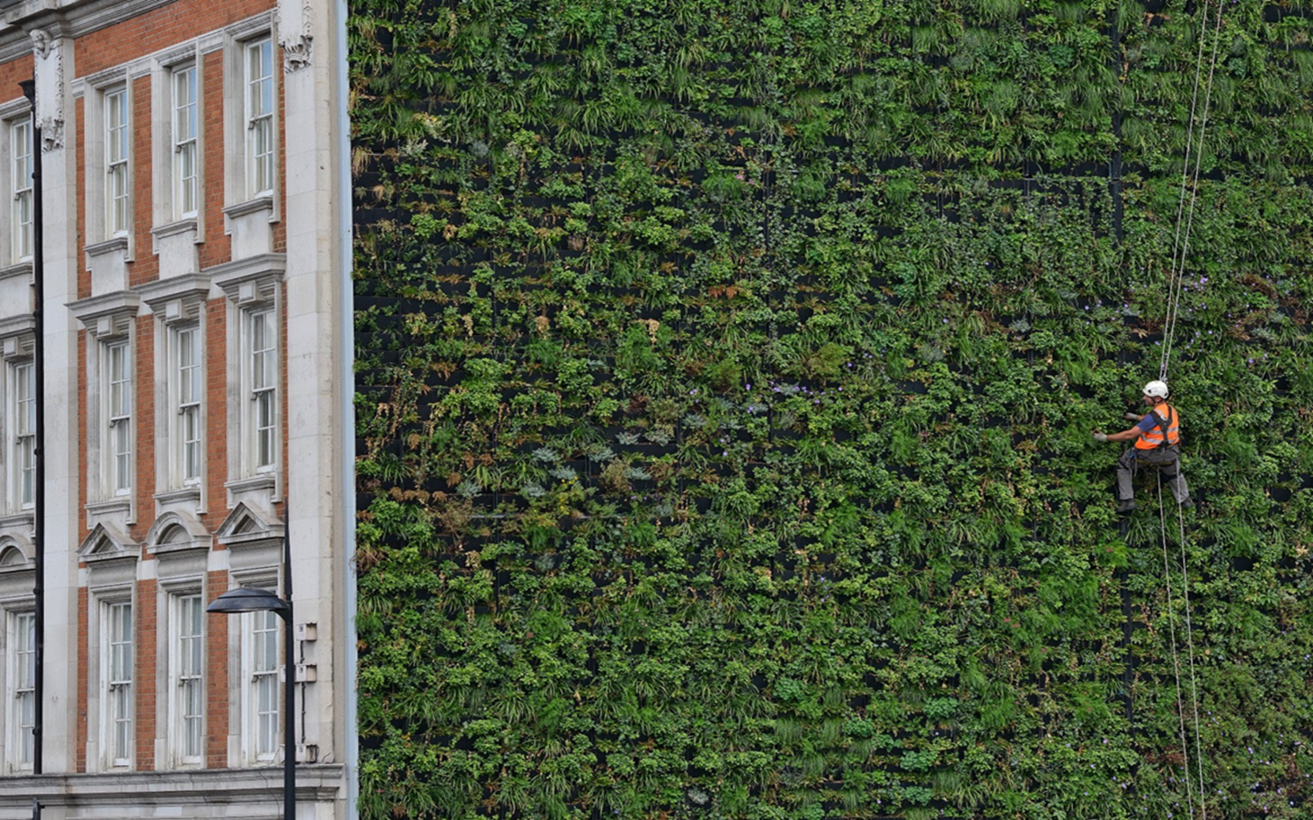
THANK YOU
peter@futurenatureconsulting.com

