Slide 1
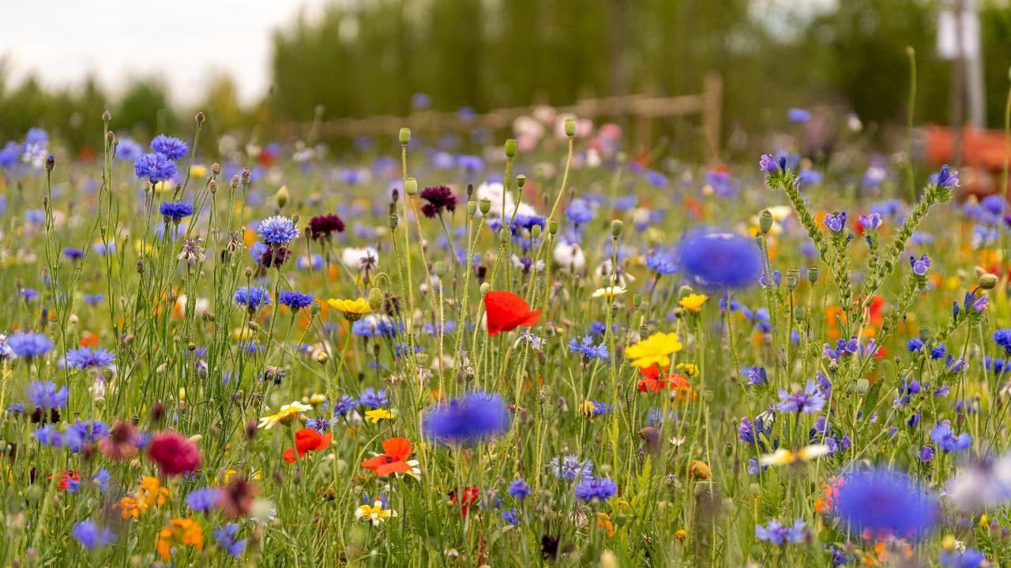
BNG – Offsite Habitat Banks
Sophie Tidy
February 2024

Slide 2
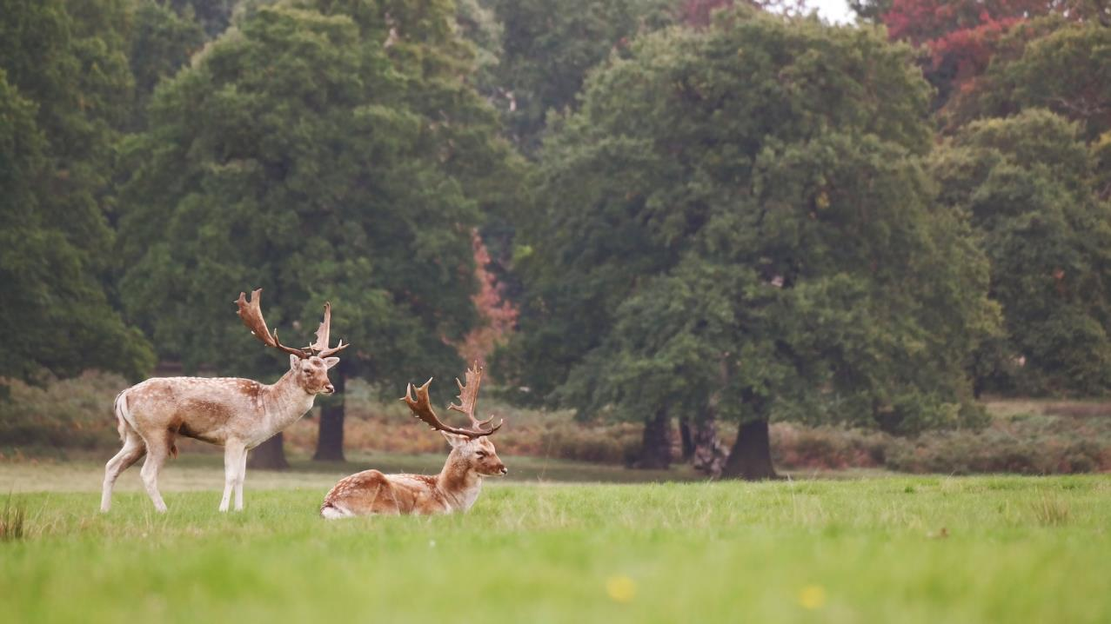
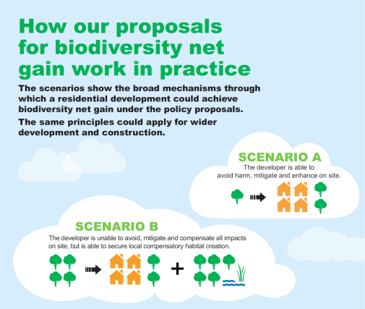
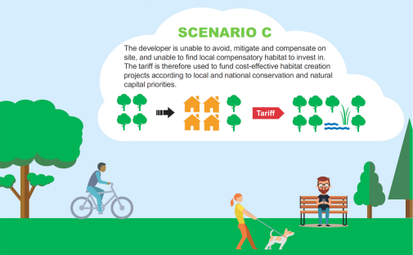
BNG Hierarchy

Slide 3
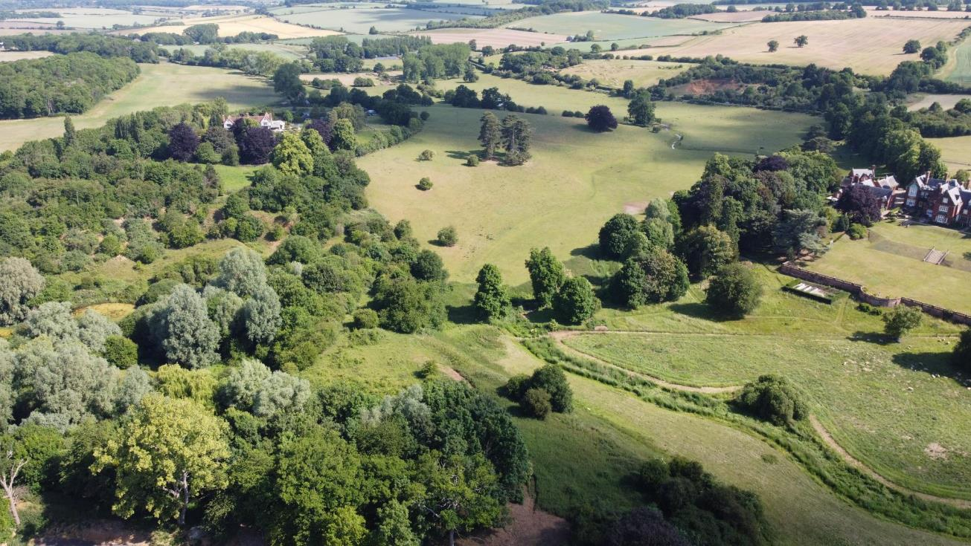
Off-site BNG
04
02
Brokerage
Proposed Habitat
Subject to HMMP being approved
Register BNG Site
Legal framework drawn up
Implement management plan
Ecologist to draw up potential achievable habitats
What management will best achieve this?
03
Management Plan
01
Final habitat agreed
Habitat Management and Monitoring Plan (HMMP) drawn up
Submitted to council for approval
Baseline Ecological Survey
Ecologist survey site
‘Baseline’ BNG units

Slide 4
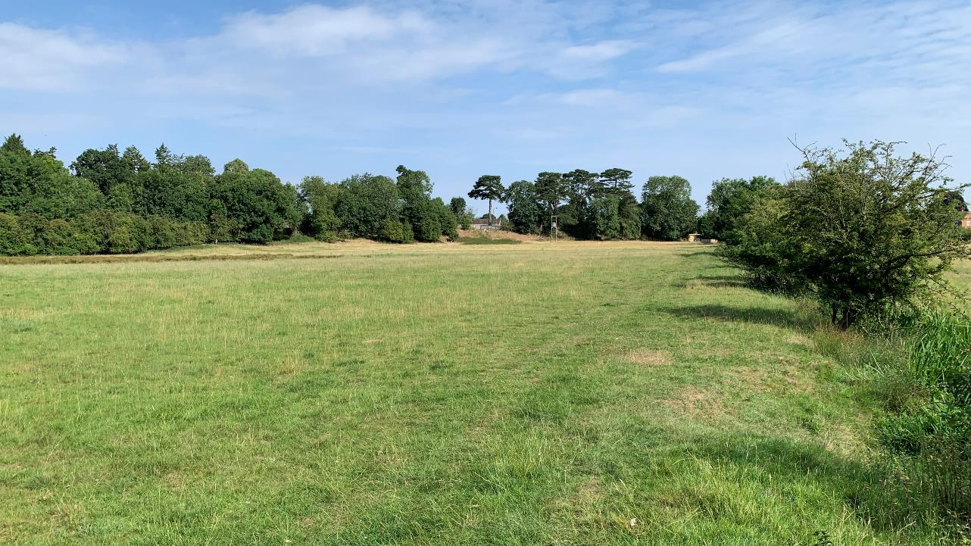
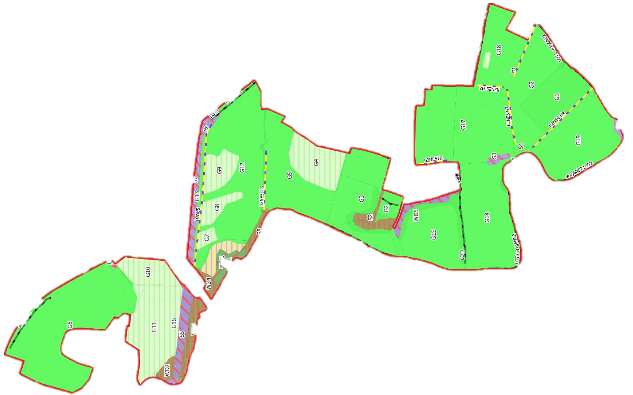


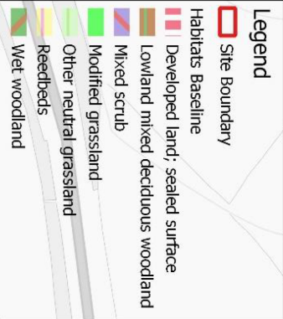
Baseline Ecological Survey
30 hectare site in Warwickshire
Regularly flooded
Unauthorised public access
Limited future options:
  Sell?
  Flood alleviation?
  Housing?
  Natural Capital

Slide 5
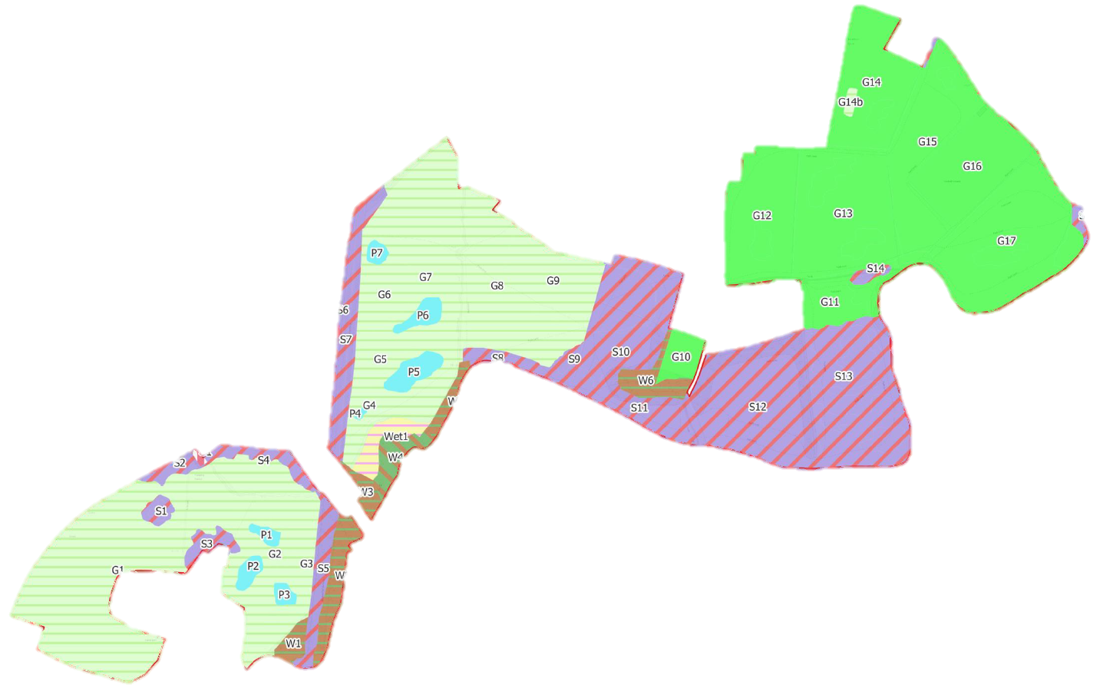
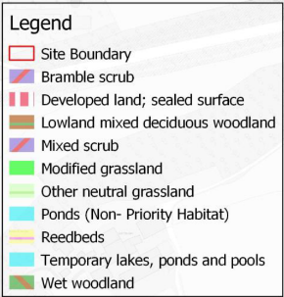

Habitat Management and Monitoring Plan

Slide 6
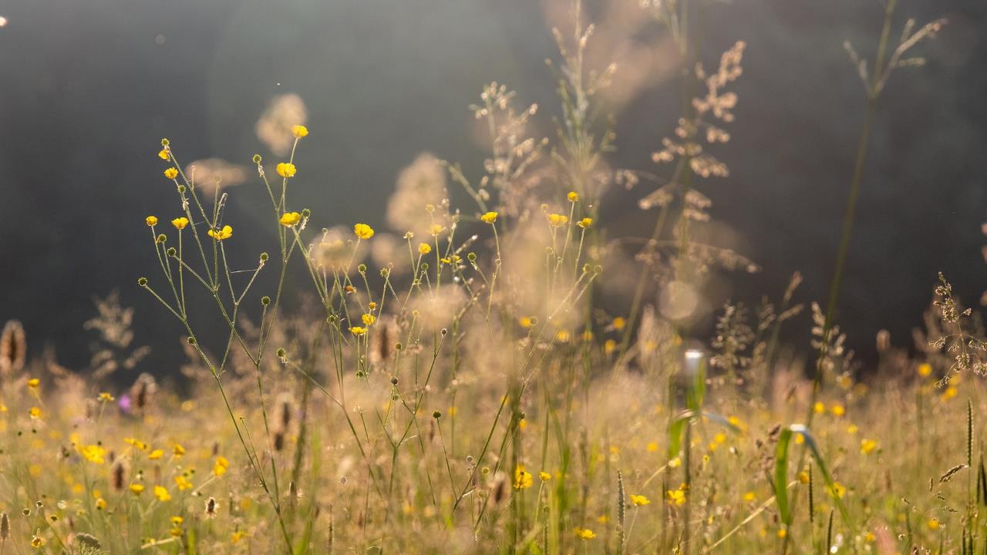





Headline Statistics
Unit Type | Baseline Value | Post Intervention Value | Change in Units | Percentage Uplift
Area Habitats | 116.28 | 235.81 | 119.52 | 102.79%
Habitat | Area (ha) | Distinctiveness | Condition | Temporal Multiplier
Other Neutral Grassland | 8.24 | Medium | Good | 10 years
Modified Grassland | 11.20 | Low | Good | 10 years
Mixed Scrub | 7.18 | Medium | Good | 10 years
Ponds | 0.59 | High | Good | 5 years
Urban Tree | 0.37 | Medium | Good | 27 years
Ongoing Management

Slide 7
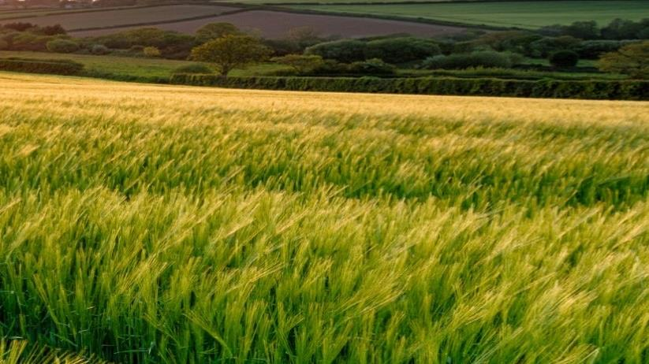
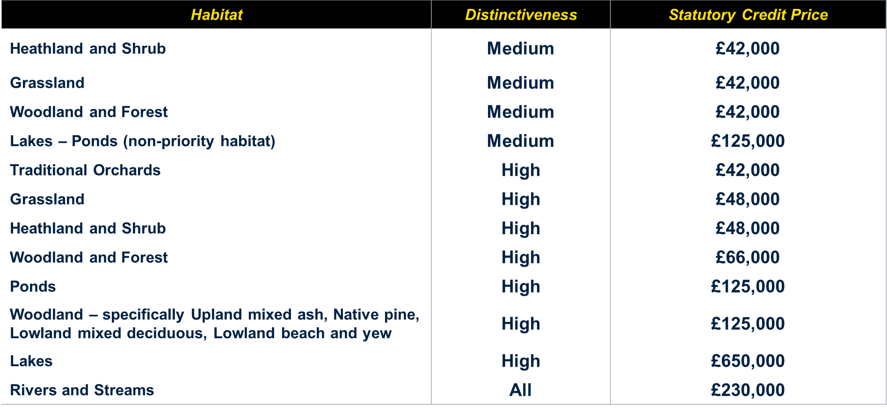
BNG – Considerations
Demand
Supply
Price: £10 - £50k /Unit
Statutory Credit Pricing
Cost of Implementation
Impact on land value
Taxation
What happens to the site after 30 years?
Notes:
Right, turning to the landowner perspective, these are the common questions being asked…
TAX:
- APR is the prime concern. Fact specific – lease for habitat creation may exceed agricultural value
• BPR may soak up any excess value or stand in for APR. Balfour assessment
• Treatment of cash – Income or capital – rent or premium?
• CGT reliefs unlikely to apply so succession plan before entering into agreements
• SDLT liability on rent and premium
• VAT at standard rate on BNG credits
What happens to the site after 30 years? Unlikely to return to agricultural use. Rebasing of the site for further enhancement and additional credit sales
Can I trash the land to create an artificially high improvement in habitat to maximise credits? No. Line in the sand – 30 January 2020
Habitat does better? Can do staged sales – if habitat goals achieved early
Can I claim for ELMS and BNG? Very important to limit the scope of agreements and define what is being delivered for each. You should be able to claim for ELMS and private schemes as long as ELMS is baselined.
Can I claim for BNG and Carbon/nutrient neutrality credits etc? Must be able to demonstrate additionality. They can be "compatible, but they must pay for different or additional outcomes and must not pay for the same outcome twice” . Furthermore, you cannot sell NN & BNG & Other credits from the same intervention. The stacking of rights is still the unknown but might be a future possibility.

Slide 8
Legal Framework
Biodiversity Gain Site Register
S.106
Conservation Covenants – responsible bodies
Purchasing Agreement
SPVs

Slide 9
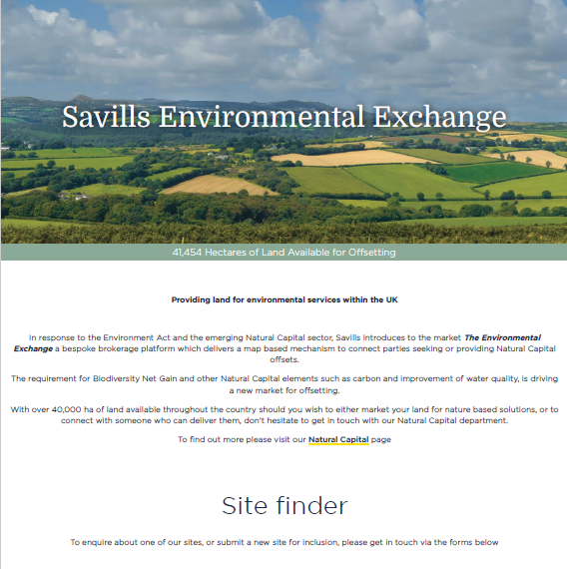
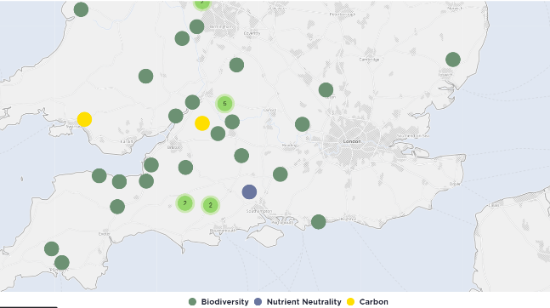
Savills Environmental Exchange

Slide 10
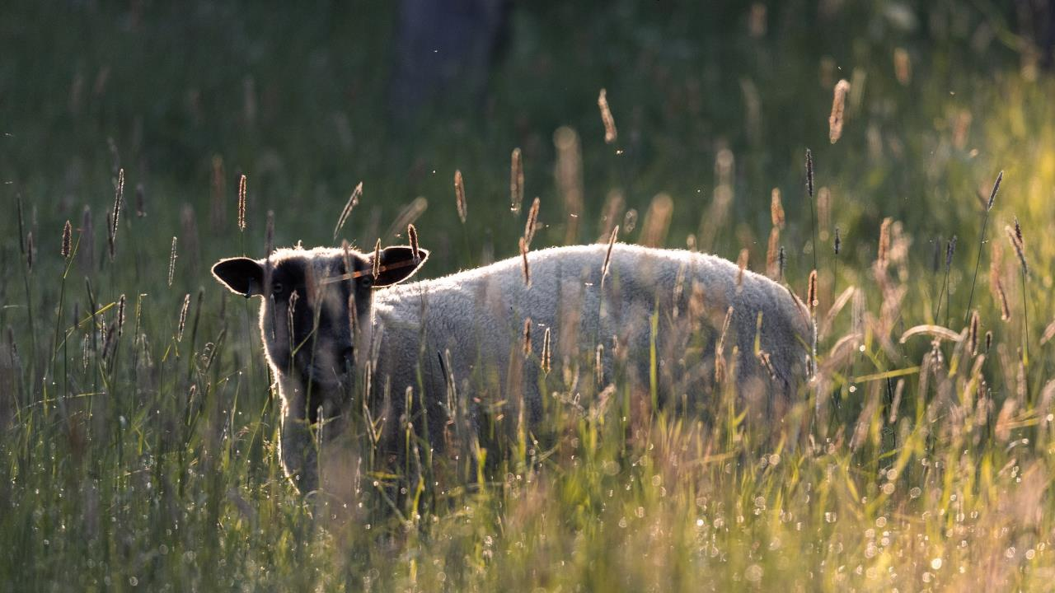
  Thank you

